Slide 1
CORONA VIRUS ANALYSIS
BY
NAMRATA SALVI
BATCH NAME:MIP-DA-09

Slide 2
OVERVIEW
The CORONA VIRUS pandemic has had a significant impact on public health and has created an urgent need for data-driven insights to understand the spread of the virus.
As a data analyst, the task is to analyze a CORONA VIRUS dataset to derive meaningful insights and present your findings.

Slide 3
DATASET
Description of each column in dataset:
Province: Geographic subdivision within a country/region.
Country/Region: Geographic entity where data is recorded.
Latitude: North-south position on Earth's surface.
Longitude: East-west position on Earth's surface.
Date: Recorded date of CORONA VIRUS data.
Confirmed: Number of diagnosed CORONA VIRUS cases.
Deaths: Number of CORONA VIRUS related deaths.
Recovered: Number of recovered CORONA VIRUS cases.

Slide 4
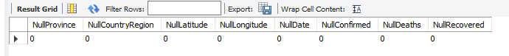
EXAMPLES
Q1. Write a code to check NULL values
SELECT
(SELECT COUNT(*) FROM CovidData WHERE Province IS NULL) AS NullProvince,
(SELECT COUNT(*) FROM CovidData WHERE Country_Region IS NULL) AS NullCountryRegion,
(SELECT COUNT(*) FROM CovidData WHERE Latitude IS NULL) AS NullLatitude, (SELECT COUNT(*) FROM CovidData WHERE Longitude IS NULL) AS NullLongitude, (SELECT COUNT(*) FROM CovidData WHERE Date IS NULL) AS NullDate, (SELECT COUNT(*) FROM CovidData WHERE Confirmed IS NULL) AS NullConfirmed, (SELECT COUNT(*) FROM CovidData WHERE Deaths IS NULL) AS NullDeaths, (SELECT COUNT(*) FROM CovidData WHERE Recovered IS NULL) AS NullRecovered;

Slide 5
-- Update NULL values in the Province column to an empty string (as it is a VARCHAR column) UPDATE CovidData SET Province = '' WHERE Province IS NULL; -- Update NULL values in the Recovered column to zero UPDATE CovidData SET Recovered = 0 WHERE Recovered IS NULL; -- Update NULL values in the Country_Region column to an empty string (as it is a VARCHAR column) UPDATE CovidData SET Country_Region = '' WHERE Country_Region IS NULL; -- Update NULL values in the Latitude column to zero UPDATE CovidData SET Latitude = 0 WHERE Latitude IS NULL;
Q2. If NULL values are present, update them with zeros for all columns.

Slide 6
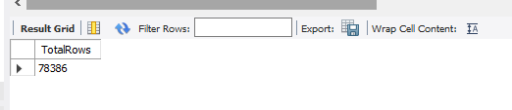
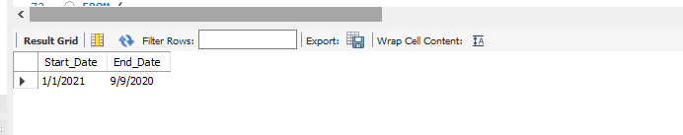
SELECT COUNT(*) AS TotalRows FROM CovidData;
Q3. check total number of rows
Q4. Check what is start_date and end_date
SELECT MIN(Date) AS Start_Date,MAX(Date) AS End_Date FROM CovidData;

Slide 7
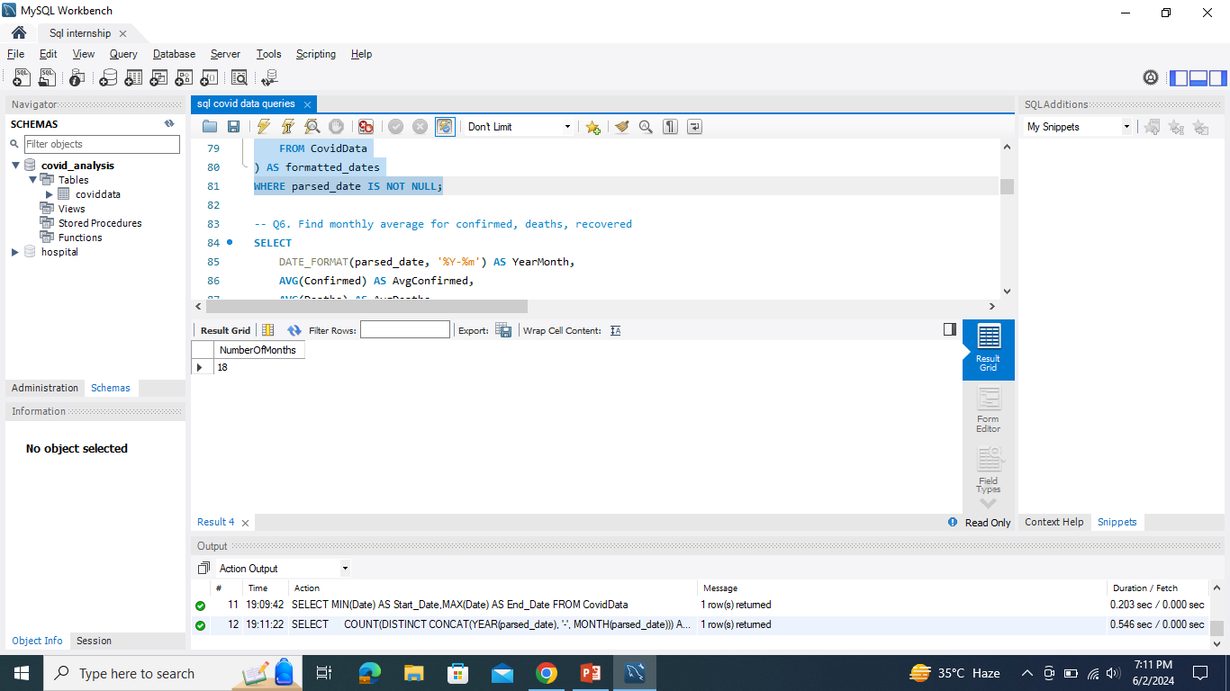
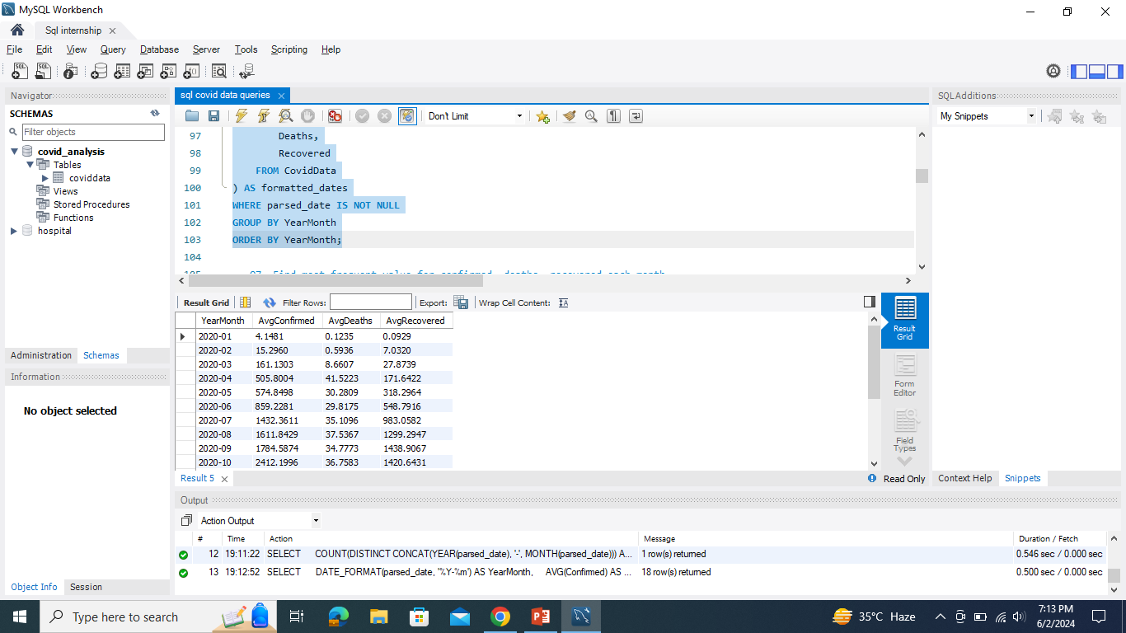
SELECT COUNT(DISTINCT CONCAT(YEAR(parsed_date), '-', MONTH(parsed_date))) AS NumberOfMonthsFROM ( SELECT CASE WHEN Date LIKE '%-%-%' THEN STR_TO_DATE(Date, '%d-%m-%Y') WHEN Date LIKE '%/%/%' THEN STR_TO_DATE(Date, '%d/%m/%Y') ELSE NULL END AS parsed_date FROM CovidData) AS formatted_datesWHERE parsed_date IS NOT NULL; Q6. Find monthly average for confirmed, deaths, recovered SELECT DATE_FORMAT(parsed_date, '%Y-%m') AS YearMonth, AVG(Confirmed) AS AvgConfirmed, AVG(Deaths) AS AvgDeaths, AVG(Recovered) AS AvgRecoveredFROM ( SELECT CASE WHEN Date LIKE '%-%-%' THEN STR_TO_DATE(Date, '%d-%m-%Y') WHEN Date LIKE '%/%/%' THEN STR_TO_DATE(Date, '%d/%m/%Y') ELSE NULL END AS parsed_date, Confirmed, Deaths, Recovered FROM CovidData) AS formatted_datesWHERE parsed_date IS NOT NULLGROUP BY YearMonthORDER BY YearMonth;
Q5. Number of month present in dataset

Slide 8
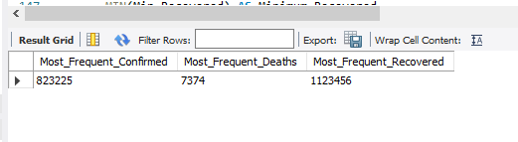
SELECT MAX(Most_Frequent_Confirmed) AS Most_Frequent_Confirmed, MAX(Most_Frequent_Deaths) AS Most_Frequent_Deaths, MAX(Most_Frequent_Recovered) AS Most_Frequent_RecoveredFROM ( SELECT MONTH(Date) AS Month, Confirmed AS Most_Frequent_Confirmed, 0 AS Most_Frequent_Deaths, 0 AS Most_Frequent_Recovered FROM CovidData GROUP BY Month, Confirmed UNION ALL SELECT MONTH(Date) AS Month, 0 AS Most_Frequent_Confirmed, Deaths AS Most_Frequent_Deaths, 0 AS Most_Frequent_Recovered FROM CovidData GROUP BY Month, Deaths UNION ALL SELECT MONTH(Date) AS Month, 0 AS Most_Frequent_Confirmed, 0 AS Most_Frequent_Deaths, Recovered AS Most_Frequent_Recovered FROM CovidData GROUP BY Month, Recovered) AS MonthlyData;
Q7. Find most frequent value for confirmed, deaths, recovered each month

Slide 9
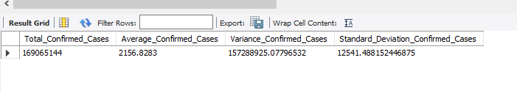
SELECT (SELECT SUM(Confirmed) FROM CovidData) AS Total_Confirmed_Cases, (SELECT AVG(Confirmed) FROM CovidData) AS Average_Confirmed_Cases, (SELECT VARIANCE(Confirmed) FROM CovidData) AS Variance_Confirmed_Cases, (SELECT STDDEV(Confirmed) FROM CovidData) AS Standard_Deviation_Confirmed_Cases;
Q11. Check how corona virus spread out with respect to confirmed case-- (Eg.: total confirmed cases, their average, variance & STDEV )

Slide 10
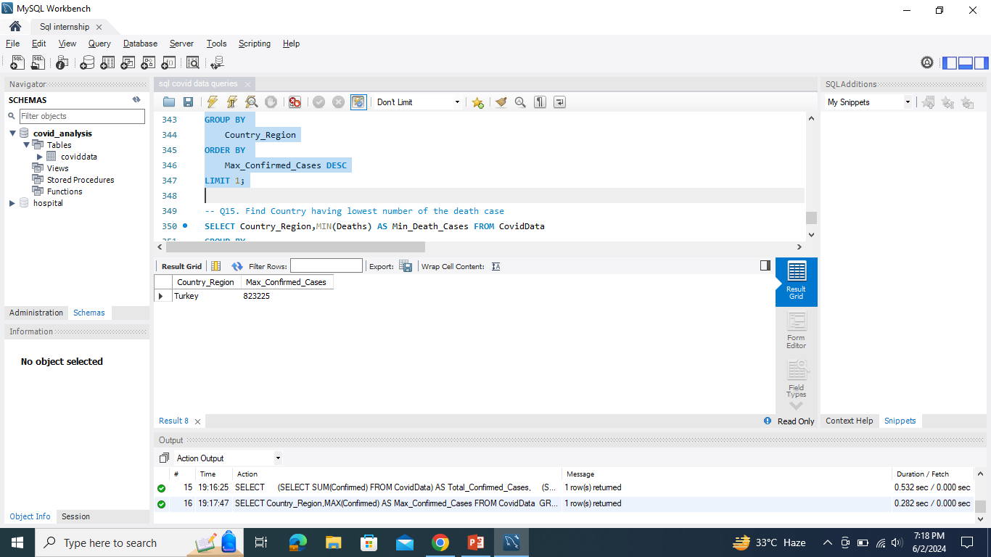
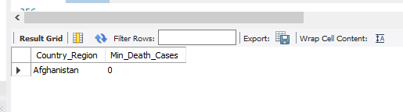
SELECT Country_Region,MAX(Confirmed) AS Max_Confirmed_Cases FROM CovidData GROUP BY Country_RegionORDER BY Max_Confirmed_Cases DESCLIMIT 1; Q15. Find Country having lowest number of the death case SELECT Country_Region,MIN(Deaths) AS Min_Death_Cases FROM CovidData GROUP BY Country_RegionORDER BY Min_Death_Cases LIMIT 1;
Q14. Find Country having highest number of the Confirmed case

Slide 11
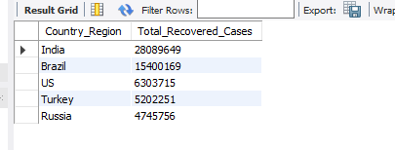

SELECT Country_Region, SUM(Recovered) AS Total_Recovered_CasesFROM CovidDataGROUP BY Country_RegionORDER BY Total_Recovered_Cases DESCLIMIT 5;
Q16. Find top 5 countries having highest recovered case

Slide 12
Insights from Analysis: Identified trends in case numbers, mortality, and recovery rates over time and across regions. Highlighted the impact of public health interventions in controlling the spread of the virus. Role of Data Analysis: Emphasized the crucial role of data-driven decision-making in managing public health emergencies. Highlighted the importance of collaborative efforts in building resilient communities and health systems.
CONCLUSION

Slide 13
THANK YOU!

